Slide 1

Presented by
-Anil Tiwari
-Sulav Nepal
-KR Dahal

Slide 2

adopts a multi-dimensional and inter-disciplinary study of employees behaviour applying principles from behavioural sciences like psychology, sociology and anthropology.
The objective is not only to study, but to predict the future behaviour of employees.
Motivation, leadership, communication, group dynamics and participative management are inbuilt in this approach, as means of securing better employee performance.
Several sociologists and psychologists like Abraham H. Maslow, Douglass McGregor, Frederic Herzberg, Chris Argyris etc. have contributed towards the development and enrichment of this approach.

Slide 3

Behavioral science developed in parallel under the overarching theory of self-actualization as described by Abraham Maslow (1954).
He was introduced the idea of self-actualization and created his pyramid theory around it.
Maslow’s ‘hierarchy of needs’ is the fundamental premise that the behavioral approach to management is built on.
The hierarchy of needs is divided into five, interdependent categories of satisfaction.

Slide 4
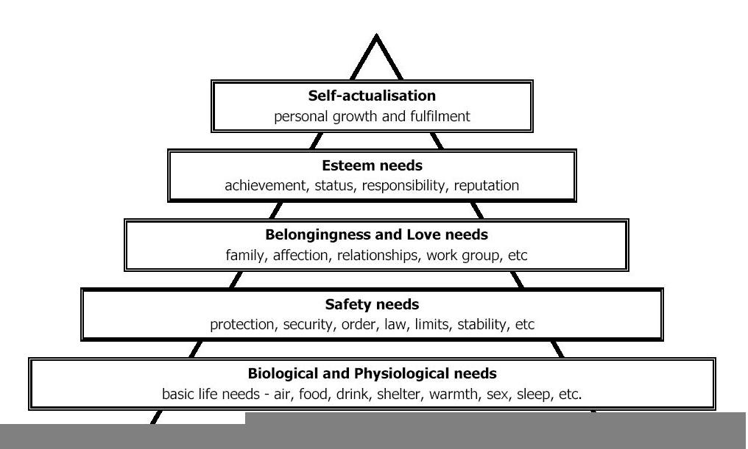

Slide 5
McGregor’s(researcher) contribution to behavioral science was the development of a Theory X and Theory Y dichotomy (McGregor, 1960).
Theory X is based on a series of assumptions that people generally do not want to work for an employer/s.
Theory Y assumptions are that people are willing and do want to work, given the right environment.

Slide 6

Management styles based on both Maslow’s needs hierarchy and McGregor’s Theory X or Y can be seen being played out in work places, large and small, around the globe.
Maslow’s hierarchy of needs influences the satisfaction of people in their working lives as much as outside work.
The adoption of methods consistent with Theory X would see managers coercing ‘lazy’ workers with bribes, rewards, threats and punishment.
Proponents of Theory Y interact and communicate effectively with staff to ensure the job they are doing suits them.

Slide 7

deals with human emotions, achievements and satisfaction.
These elements will always dictate the productivity and outcome of an organization so long as that organization continues to employ people.
Douglas McGregor and Abraham Maslow dedicated their lives to the understanding of human behavior and its application in organizational management.
other psychologists, management theorists and sociologists have taken the behavioral approach further raising debates on the advantages and disadvantages of this theory.

